Slide 1
The Battle of Neighbourhoods: London vs. Birmingham

Slide 2
Comparing Cities for Chinese Immigrants
- Moving to another country is a major life decision. Sufficient research of destinations is required to make the best decision.
- Analysis of network of Chinese communities and venues can help immigrants decide which city to move to.
- Business owners in Chinese dense areas will also be interested to see where their business lies with respect with the Chinese community.

Slide 3
Data Wrangling
- London Neighbourhoods scraped from https://en.wikipedia.org/wiki/List_of_areas_of_London
- 295 London Neighbourhoods remained after cleaning.
- Birmingham Neighbourhoods scraped from https://en.wikipedia.org/wiki/List_of_neighbourhoods_of_Birmingham
- 185 Birmingham Neighbourhoods remained after cleaning.
- Geographical coordinates obtained with Geocoder.
- Venue information obtained from Foursquare API at https://foursquare.com/

Slide 4
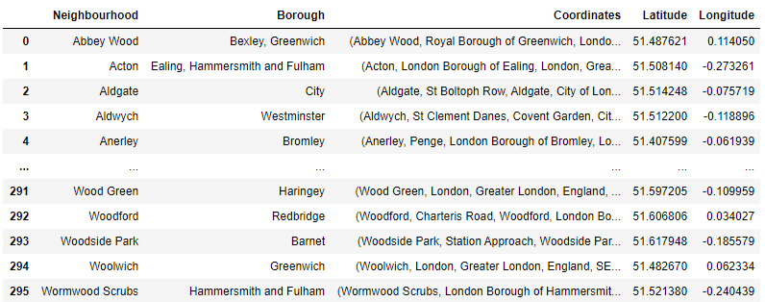
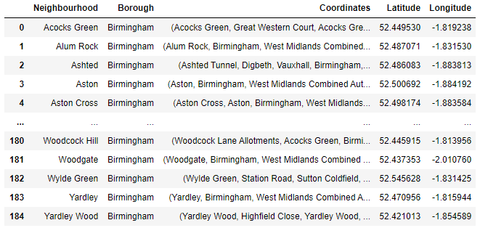
Obtaining Neighbourhood Locations
Table of London Neighbourhoods
Table of Birmingham Neighbourhoods

Slide 5
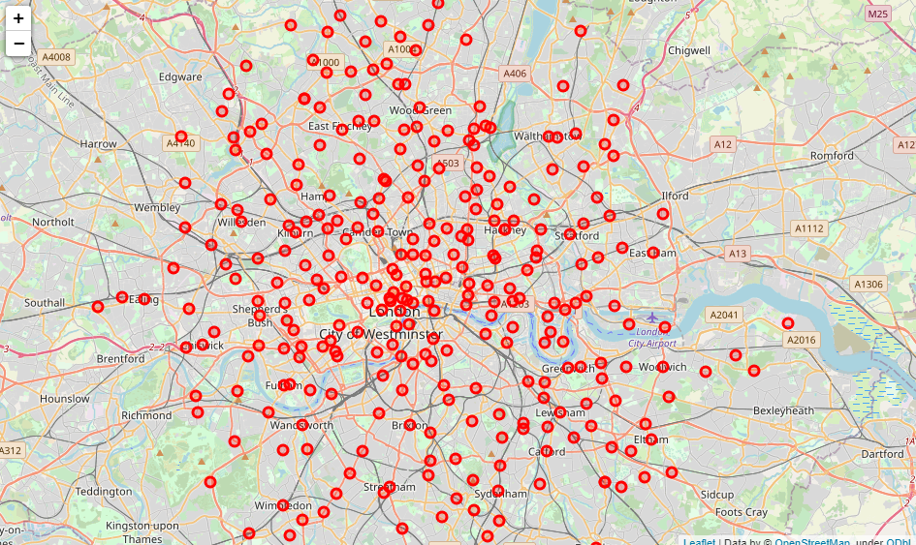
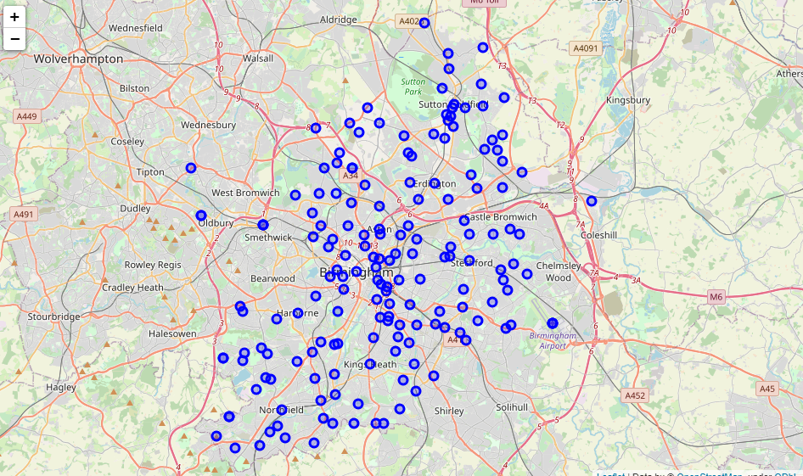
Visualising Neighbourhoods as potential Locations
Map of London Neighbourhoods
Map of Birmingham Neighbourhoods

Slide 6
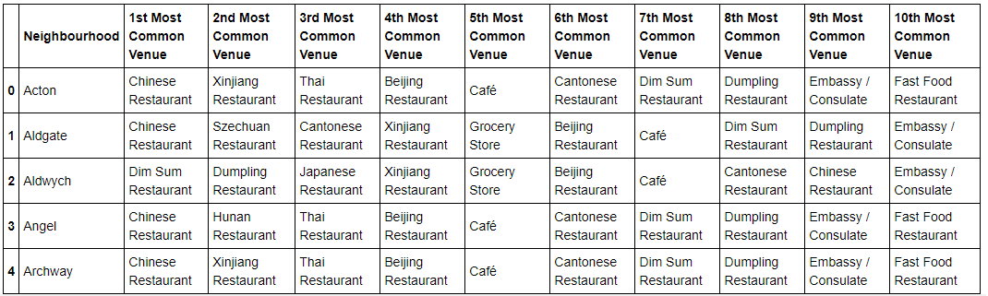
Most Common Venues in London
Most venues are different types of restaurants.
There are also different venues such as Cafes, Grocery Stores, and the Chinese Embassy

Slide 7
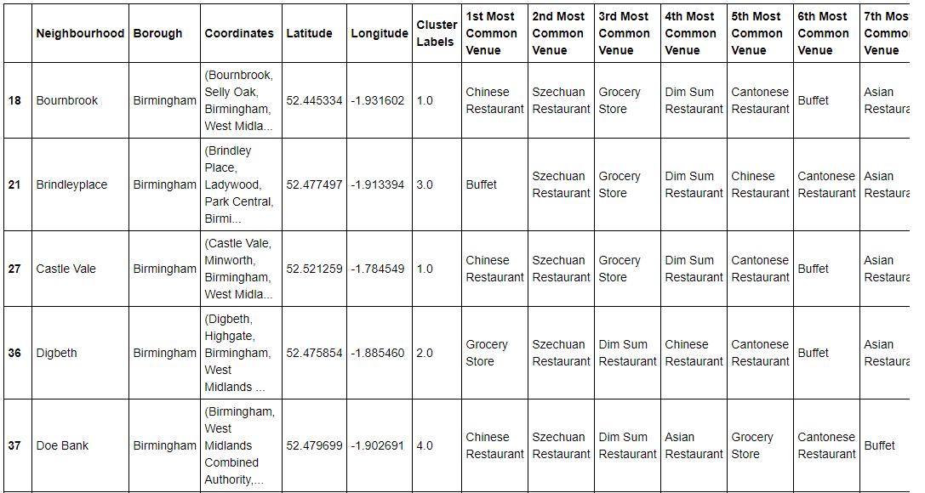
Most Common Venues in Birmingham
Vast majority of venues are restaurants
Few of other types of venues, Grocery Stores are the next most common venue

Slide 8
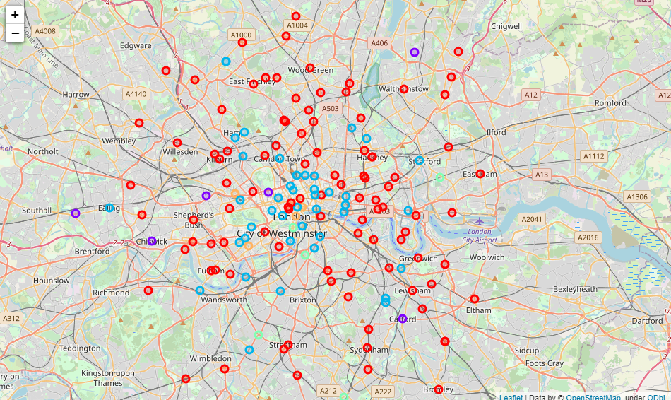
Cluster of Chinese Venues in London
Extensive network of clusters.
Lots of Chinese venues throughout.
Red spots indicate the cluster with most amount of Chinese venues nearby.

Slide 9
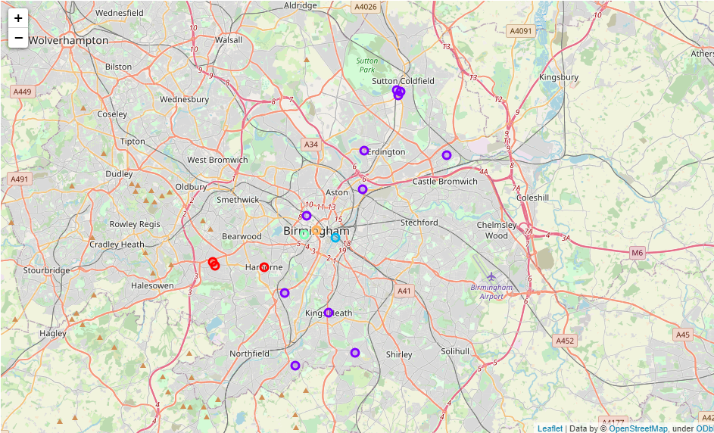
Cluster of Chinese Venues in Birmingham
Sparse clusters of Chinese venues.
Purple spots indicate neighbourhoods with most Chinese venues.
Few venues throughout.

Slide 10
Conclusions
- Gathered useful data on neighbourhoods and venues for London and Birmingham
- Captured the main clusters in each city that has the densest concentration of Chinese venues.
- If the immigrant is seeking a job, then job locations could be included in the map.
- Is not an exhaustive report. Many other factors could be included such as:
Average living costs in each neighbourhood.
Useful venues such as nearby banks, language schools, communities in addition to Chinese venues.
Nearby transportation and ease of access.
This project aims to give a further idea of potential locations in two of UK’s major cities. It hopes to provide the reader some insight on what to expect from Chinese communities and where they can expect to find them.

